Slide 1

Guide to Networking Essentials 7th Edition
Topic 01
Network Topologies and Technologies
Notes:
Network+ Guide to Networks 7th Edition
Chapter 3
Network Topologies and Technologies

Slide 2
Objectives
Describe the primary physical networking topologies in common use
Describe the primary logical networking topologies in common use
Describe major LAN networking technologies
Compare Wi-Fi standards
Notes:
Objectives
Describe the primary physical networking topologies in common use
Describe the primary logical networking topologies in common use
Describe major LAN networking technologies
Compare Wi-Fi standards

Slide 3
Physical Topologies
Topology: describes the lay of the land (configuration)
A network topology describes how a network is physically laid out and how signals travel from one device to another
The physical layout of the devices and cables doesn’t describe how signals travel from one device to another
Hence network topologies are categorized into physical and logical topologies
Notes:
Physical Topologies
Topology: describes the lay of the land
A network topology describes how a network is physically laid out and how signals travel from one device to another
The physical layout of the devices and cables doesn’t describe how signals travel from one device to another
Network topologies are categorized into physical and logical topologies

Slide 4
Physical Topologies
The arrangement of cabling and how cables connect one device to another in a network is considered the network’s physical topology
The path data travels between computers on a network is considered the network’s logical topology
All network designs today are based on these basic physical topologies: bus, star, ring, meshed and point-to-point
Notes:
Physical Topologies
The arrangement of cabling and how cables connect one device to another in a network is considered the network’s physical topology
The path data travels between computers on a network is considered the network’s logical topology
All network designs today are based on these basic physical topologies: bus, star, ring, and point-to-point

Slide 5
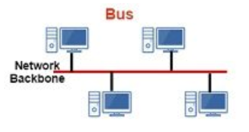
Physical Bus Topology
Physical bus topology is defined as a continuous length of cable connecting one computer to another in daisy-chain fashion
The simplest and at one time the most common method for connecting computers
Weaknesses
There’s a limit of 30 computers per cable segment
The maximum total length of cabling is 185 meters
Both ends of the bus must be terminated (terminator at the both ends of the cable)
Any break in the bus brings down the entire network
Notes:
Physical Bus Topology
Physical bus topology is defined as a continuous length of cable connecting one computer to another in daisy-chain fashion
The simplest and at one time the most common method for connecting computers
Weaknesses
There’s a limit of 30 computers per cable segment
The maximum total length of cabling is 185 meters (can be extended by adding repeaters between segments)
Both ends of the bus must be terminated (otherwise signal will echo back into the cable and cause collision, bringing down the network)
Any break in the bus brings down the entire network
5/4/3 rules:
5 segments connected by 4 repeaters, only 3 segments can have computers/devices.

Slide 6
Physical Bus Topology
Weaknesses (cont’d)
Adding or removing a machine brings down the entire network temporarily
Technologies using this topology are limited to 10 Mbps half-duplex communication since they use coaxial cabling
Due to the limitations, this topology is no longer a practical choice and technology has moved past this obsolete method of connecting computers
Notes:
Physical Bus Topology
Weaknesses (cont’d)
Adding or removing a machine brings down the entire network temporarily
Technologies using this topology are limited to 10 Mbps half-duplex communication since they use coaxial cabling
Due to the limitations, this topology is no longer a practical choice and technology has moved past this obsolete method of connecting computers

Slide 7
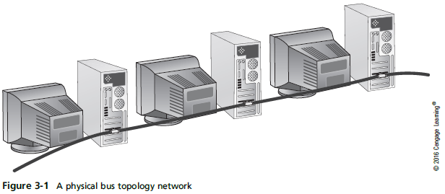
Physical Bus Topology
Notes:
Physical Bus Topology

Slide 8
How Data Travels in a Physical Bus
Electrical pulses (signals) travel the cable’s length in all directions
Signal travel across the medium and from device to device is called signal propagation
Signal continues until it weakens or is absorbed by terminator ( at the end of both ends of the cable )
A terminator is an electrical component called a resistor that absorbs the signal instead of allowing it to bounce back up the wire
If not terminated, signal bounces or is “reflected” at end of medium (BAD)
Signal bounce is the term used when electricity bounces off the end of a cable and back in the other direction (causes echo)
Notes:
How Data Travels in a Physical Bus
Electrical pulses (signals) travel the cable’s length in all directions
Signal travel across the medium and from device to device is called signal propagation
Signal continues until it weakens or is absorbed by terminator
A terminator is an electrical component called a resistor that absorbs the signal instead of allowing it to bounce back up the wire
If not terminated, signal bounces or is “reflected” at end of medium
Signal bounce is the term used when electricity bounces off the end of a cable and back in the other direction

Slide 9
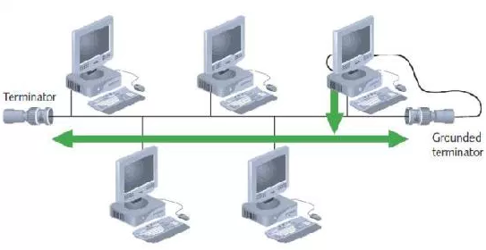
Data signals travel to both ends of the bus

Slide 10
Physical Bus Limitations
Only 30 computers can be daisy-chained together
Before signal becomes too weak to be passed along to another computer
As an electrical signal encounters each workstation along a daisy-chain
Some of its strength is absorbed by both the cabling and the connectors until the signal is too weak for a NIC to interpret
For the same reason, total length of cabling is limited to 185 meters
Notes:
Physical Bus Limitations
Only 30 computers can be daisy-chained together
Before signal becomes too weak to be passed along to another computer
As an electrical signal encounters each workstation along a daisy-chain
Some of its strength is absorbed by both the cabling and the connectors until the signal is too weak for a NIC to interpret
For the same reason, total length of cabling is limited to 185 meters

Slide 11
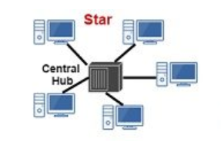
Physical Star Topology
Uses a central device (hub or switch) to connect computers
Advantages:
Much faster technologies than a bus
Centralized monitoring and management of network traffic are possible
Easier network upgrades
Detecting errors ( checksum )
Notes:
Physical Star Topology
Uses a central device (hub or switch) to connect computers
Advantages:
Much faster technologies than a bus
Centralized monitoring and management of network traffic are possible
Easier network upgrades

Slide 12
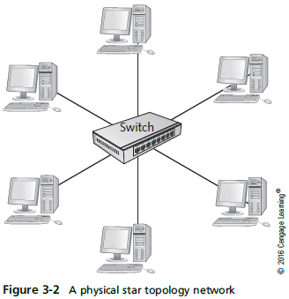
Physical Star Topology
Notes:
Physical Star Topology

Slide 13
Physical Star Topology
Using a central device allows for monitoring and managing a network
Hubs and switches can include software that collects statistics about network traffic patterns and detect errors
As long as cabling and NICs support it, a star network can be easily updated by replacing the central device (for higher speed if needed e.g. 100Mbps to 1Gbps)
When the number of workstations you need exceed the number of ports on a central device you simply add another central device ( extended star )
Notes:
Physical Star Topology
Using a central device allows for monitoring and managing a network
Hubs and switches can include software that collects statistics about network traffic patterns and detect errors
As long as cabling and NICs support it, a star network can be easily updated by replacing the central device
When the number of workstations you need exceed the number of ports on a central device you simply add another central device

Slide 14
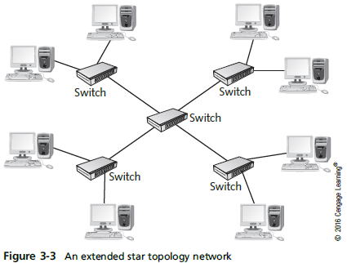
Extended Star
When several hubs or switches must be connected, usually one device is used as the central connecting point, forming an extended star topology
Notes:
Extended Star
When several hubs or switches must be connected, usually one device is used as the central connecting point, forming an extended star topology

Slide 15
Extended Star
Most widely used in networks containing more than just a few computers
A central device (usually a switch) sits in the middle and instead of attached computers, other switches or hubs are connected to the central switch’s ports
Computers and peripherals are then attached to these switches or hubs forming additional stars
Sometimes referred to as a “hierarchical star”
Notes:
Extended Star
Most widely used in networks containing more than just a few computers
A central device (usually a switch) sits in the middle and instead of attached computers, other switches or hubs are connected to the central switch’s ports
Computers and peripherals are then attached to these switches or hubs forming additional stars
Sometimes referred to as a “hierarchical star”

Slide 16
Hierarchical Star

Slide 17
How Data Travels in a Physical Star
Depends on the type of central device
Central device determines ‘logical’ topology
Logical topology is discussed later in the chapter
For now: hub = logical bus; switch = logical switching; MAU = logical ring
Notes:
How Data Travels in a Physical Star
Depends on the type of central device
Central device determines ‘logical’ topology
Logical topology is discussed later in the chapter
For now: hub = logical bus; switch = logical switching; MAU = logical ring

Slide 18
Physical Star Disadvantages
There are many advantages of a physical star
There is one disadvantage
The central device represents a single point of failure
If the hub or switch fails or someone kicks the power cord out of the outlet, the entire network goes down
Having a spare on hand is a good idea
Notes:
Physical Star Disadvantages
There are many advantages of a physical star
There is one disadvantage
The central device represents a single point of failure
If the hub or switch fails or someone kicks the power cord out of the outlet, the entire network goes down
Having a spare on hand is a good idea

Slide 19
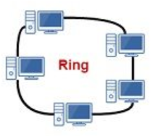
Physical Ring Topology
A physical ring topology is like a bus
Devices are daisy-chained one to another
Instead of terminating each end, the cabling is brought around from the last device back to the first device to form a ring
Most widely used to connect LANs with a technology called Fiber Distributed Data Interface (FDDI)
FDDI was most often used as a network backbone, which is cabling used to communicate between LANs or between hubs and switches
Notes:
Physical Ring Topology
A physical ring topology is like a bus
Devices are daisy-chained one to another
Instead of terminating each end, the cabling is brought around from the last device back to the first device to form a ring
Most widely used to connect LANs with a technology called Fiber Distributed Data Interface (FDDI)
FDDI was most often used as a network backbone, which is cabling used to communicate between LANs or between hubs and switches

Slide 20
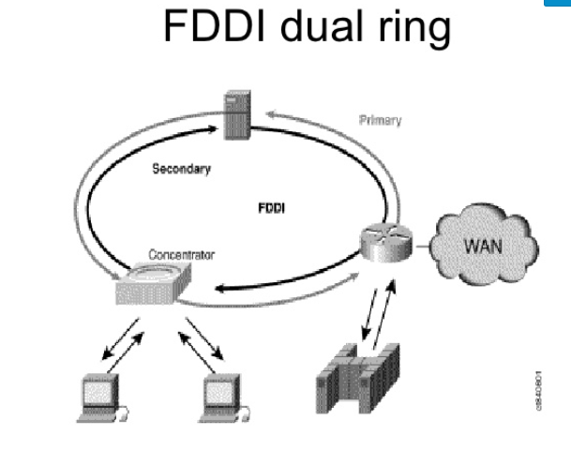
FDDI is used as a high speed backbone to connect servers, switches (which connects LANs) and terminal concentrators (which connects terminals)
2 fibre optic cables for higher speed + backup if one fails

Slide 21
Physical Ring Topology
Data travels in one direction
If any station in the ring fails, data can no longer be passed along
FDDI uses dual ring
Data travels in both directions
One ring failure doesn’t break network
Operates using fiber-optic cable at 100 Mbps
Extended star topologies with Gigabit Ethernet has largely replaced FDDI
Notes:
Physical Ring Topology
Data travels in one direction
If any station in the ring fails, data can no longer be passed along
FDDI uses dual ring
Data travels in both directions
One ring failure doesn’t break network
Operates using fiber-optic cable at 100 Mbps
Extended star topologies with Gigabit Ethernet has largely replaced FDDI

Slide 22
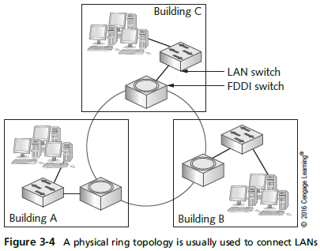
Physical Ring Topology
Notes:
Physical Ring Topology

Slide 23
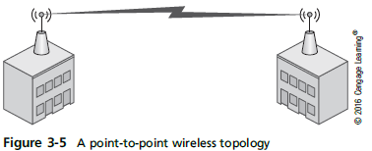
Point-to-Point Topology
Direct link between two devices
Mostly used in WANs (connecting say HQ in New York to branch office in Tokyo)
Wireless bridge (connect 2 LANs separated by highway, river or railway tracks)
Used to connect two computers
Notes:
Point-to-Point Topology
Direct link between two devices
Mostly used in WANs
Wireless bridge
Used to connect two computers

Slide 24
Point-to-Multipoint Topology
Point-to-multipoint (PMP) topology – a central device communicates with two or more other devices
All communication goes through the central device
Often used in WANs where a main office has connections to several branch offices via a router
A single connection is made from the router to a switching device that directs traffic to the correct branch office
Also used in wireless network arrangements
(wi- max)
Notes:
Point-to-Multipoint Topology
Point-to-multipoint (PMP) topology – a central device communicates with two or more other devices
All communication goes through the central device
Often used in WANs where a main office has connections to several branch offices via a router
A single connection is made from the router to a switching device that directs traffic to the correct branch office
Also used in wireless network arrangements

Slide 25
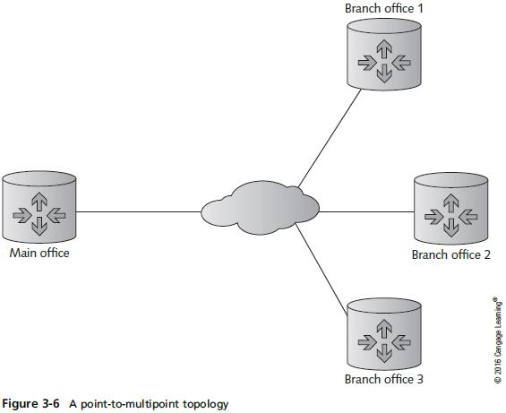
Point-to-Multipoint Topology
Notes:
Point-to-Multipoint Topology

Slide 26
Mesh Topology
Connects each device to every other device in a network
Multiple point-to-point connections for the purposes of redundancy and fault tolerance
Purpose of creating a mesh topology is to ensure that if one or more connections fail, there’s another path for reaching all devices on the network
Expensive due to multiple interfaces and cabling
Found in large WANs and internetworks
Notes:
Mesh Topology
Connects each device to every other device in a network
Multiple point-to-point connections for the purposes of redundancy and fault tolerance
Purpose of creating a mesh topology is to ensure that if one or more connections fail, there’s another path for reaching all devices on the network
Expensive due to multiple interfaces and cabling
Found in large WANs and internetworks

Slide 27
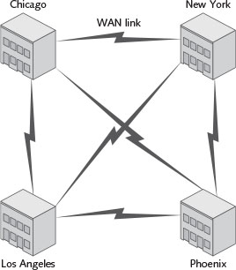
Mesh Topology
Figure 3-7 Switches in each building are connected in a full mesh topology
Notes:
Mesh Topology
Fully meshed networks require n (n – 1) /2 connectons,

Slide 28
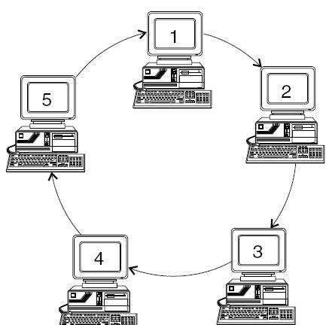
Logical Topologies
Describes how data travels from computer to computer
Sometimes same as physical topology
In a physical bus and physical ring, the logical topology mimics the physical arrangement of cables
Physical Bus and Logical Bus
Physical Ring and Logical Ring
For physical star, electronics in central device determine logical topology
Notes:
Logical Topologies
Describes how data travels from computer to computer
Sometimes same as physical topology
In a physical bus and physical ring, the logical topology mimics the physical arrangement of cables
For physical star, electronics in central device determine logical topology

Slide 29
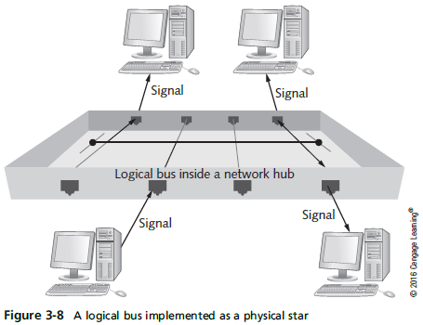
Logical Topologies
Notes:
Logical Topologies

Slide 30
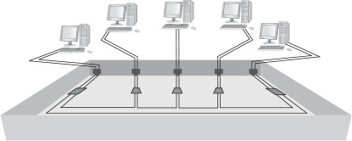
Logical Topologies
A logical ring using a physical star implements the ring inside the central device’s electronics, which is a MAU ( multistation access unit) in the token ring technology
Notes:
Logical Topologies
A logical ring using a physical star implements the ring inside the central device’s electronics, which is a MAU in the token ring technology

Slide 31
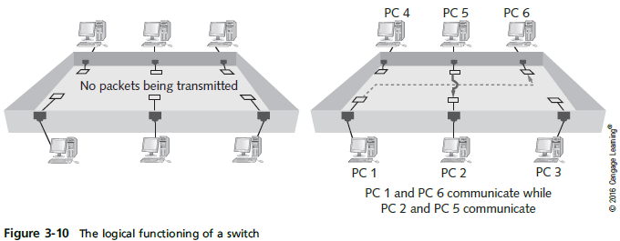
Logical Topologies
In a switched topology, there is always an electrical connection between the computer and the switch
But when no data is being transferred there is no logical connection or circuit between the devices
Notes:
Logical Topologies
In a switched topology, there is always an electrical connection between the computer and the switch
But when no data is being transferred there is no logical connection or circuit between the devices

Slide 32
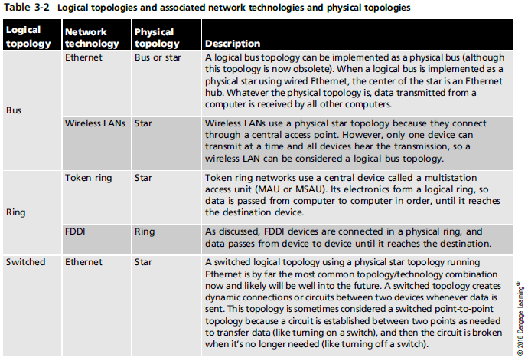
Logical Topologies
Notes:
Logical Topologies

Slide 33
Layers ( People don’t need to see president America )
Application
Presentation Session
Transport Network Data Physical

Slide 34
Network Technologies
Network technology is the method a NIC uses to access the medium and send data frames
Other terms:
Network interface layer technologies
Network architectures
Data link layer technologies
Basically, it is whether your network uses Ethernet, 802.11 wireless, token ring, or some combination of these to move data from device to device in your network
Notes:
Network Technologies
Network technology is the method a NIC uses to access the medium and send data frames
Other terms:
Network interface layer technologies
Network architectures
Data link layer technologies
Basically, it is whether your network uses Ethernet, 802.11 wireless, token ring, or some combination of these to move data from device to device in your network

Slide 35
Network Technologies
LAN examples include
Ethernet
802.11 wireless ( Wi-fi )
Token Ring
WAN examples include
Frame relay
FDDI
ATM ( Asynchronous transfer mode )
Gigabit Ethernet ( Nowadays )
Network technology often defines frame format and media
Notes:
Network Technologies
LAN examples include
Ethernet
802.11 wireless
Token Ring
WAN examples include
Frame relay
FDDI
ATM
Network technology often defines frame format and media

Slide 36
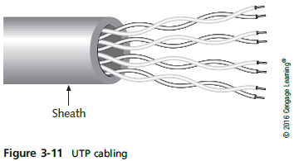
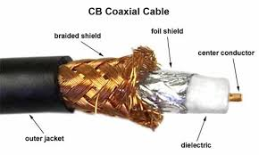
Network Technologies and Media
Unshielded Twisted pair (UTP)
Most common media type in LANs
Consists of 4 pairs of copper wires
each twisted together (Minimizes the EMI, electro magnetic interference)
Comes in numbered categories
Fiber-optic cabling uses thin strands of glass to carry pulses of light long distances and at high data rates
Coaxial cable is obsolete as a LAN medium but it is used as the network medium for Internet access via cable modem
Notes:
Network Technologies and Media
Unshielded Twisted pair (UTP)
Most common media type in LANs
Consists of 4 pairs of copper wires
each twisted together
Comes in numbered categories e.g. Cat 3,4,5,6 etc
Fiber-optic cabling uses thin strands of glass to carry pulses of light long distances and at high data rates
Coaxial cable is obsolete as a LAN medium but it is used as the network medium for Internet access via cable modem

Slide 37
Categories of UTP Cables

Slide 38
Baseband and Broadband Signaling
Network technologies can use media to transmit signals in two main ways
Baseband sends digital signals in which each bit of data is represented by a pulse of electricity or light
Sent at a single fixed frequency and no other frames can be sent along with it (no more than 1 frame can be sent at the same time)
Broadband uses analog techniques to encode binary 1s and 0s across a continuous range of values
Signals flow at a particular frequency and each frequency represents a channel of data (can have several transmissions occurring at the same time)
Notes:
Baseband and Broadband Signaling
Network technologies can use media to transmit signals in two main ways
Baseband sends digital signals in which each bit of data is represented by a pulse of electricity or light
Sent at a single fixed frequency and no other frames can be sent along with it
Broadband uses analog techniques to encode binary 1s and 0s across a continuous range of values
Signals flow at a particular frequency and each frequency represents a channel of data.
(can have several transmissions occurring at the same time – each on different frequency - channel)

Slide 39
Ethernet Networks
Ethernet is the most popular LAN technology
Easy to install and support with a low-cost factor
It is baseband
Supports a broad range of speeds: 10 Mbps to 10 Gbps
Can operate in physical bus or physical star and logical bus or switched logical topology
Most NICs/hubs/switches can operate at multiple speeds: 10/100/1000
Underlying technology is the same
Notes:
Ethernet Networks
Ethernet is the most popular LAN technology
Easy to install and support with a low cost factor
Supports a broad range of speeds: 10 Mbps to 10 Gbps
Can operate in physical bus or physical star and logical bus or switched logical topology
Most NICs/hubs/switches can operate at multiple speeds: 10/100/1000
Underlying technology is the same

Slide 40
Ethernet Addressing
Every station has a physical (MAC) address
Each MAC address has 48 bits expressed as 12 hexadecimal digits
Incoming frames must match NIC’s address or broadcast address (FF-FF-FF-FF-FF-FF). First 6 digits represent manufacturer
Once processed by NIC, incoming frames are sent to the network protocol for further processing
Notes:
Ethernet Addressing
Every station has a physical (MAC) address
Each MAC address has 48 bits expressed as 12 hexadecimal digits
Incoming frames must match NIC’s address or broadcast address (FF-FF-FF-FF-FF-FF).
Once processed by NIC, incoming frames are sent to the network protocol for further processing

Slide 41
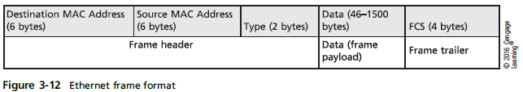
Ethernet Frames
Four different formats or frame types –depending on the network protocol used to send the frame
Ethernet II frame type used by TCP/IP
TCP/IP has become the dominant network protocol in LANs so supporting multiple frame types has become unnecessary
Frames must be between 64 and 1518 bytes
Destination MAC
Source MAC
Type
Data
FCS ( Frame check sum )
Notes:
Ethernet Frames
Four different formats or frame types –depending on the network protocol used to send the frame
Ethernet II frame type used by TCP/IP
TCP/IP has become the dominant network protocol in LANs so supporting multiple frame types has become unnecessary
Frames must be between 64 and 1518 bytes
Destination MAC
Source MAC
Type
Data
FCS

Slide 42
Ethernet Media Access
Media access method: Rules governing how and when the medium can be accessed for transmission
Ethernet uses Carrier Sense Multiple Access with Collision Detection (CSMA/CD)
Carrier Sense: Listen before send – must hear silence
Multiple Access: If two or more stations hear silence, multiple stations may transmit at the same time
Collision Detection: If two or more stations transmit, a collision occurs and is detected by the NIC; all stations must retransmit
Simulation 7 : CSMA/CD Ethernet
Notes:
Ethernet Media Access
Media access method: Rules governing how and when the medium can be accessed for transmission
Ethernet uses Carrier Sense Multiple Access with Collision Detection (CSMA/CD)
Carrier Sense: Listen before send – must hear silence
Multiple Access: If two or more stations hear silence, multiple stations may transmit at the same time
Collision Detection: If two or more stations transmit, a collision occurs and is detected by the NIC; all stations must retransmit

Slide 43
Collisions and Collision Domains
All devices interconnected by one or more hubs hear all signals generated by all other devices
The extent to which signals in an Ethernet bus topology network are propagated is called a collision domain
All devices in a collision domain are subject to the possibility that whenever a device sends a frame, a collision might occur
Notes:
Collisions and Collision Domains
All devices interconnected by one or more hubs hear all signals generated by all other devices
The extent to which signals in an Ethernet bus topology network are propagated is called a collision domain
All devices in a collision domain are subject to the possibility that whenever a device sends a frame, a collision might occur

Slide 44
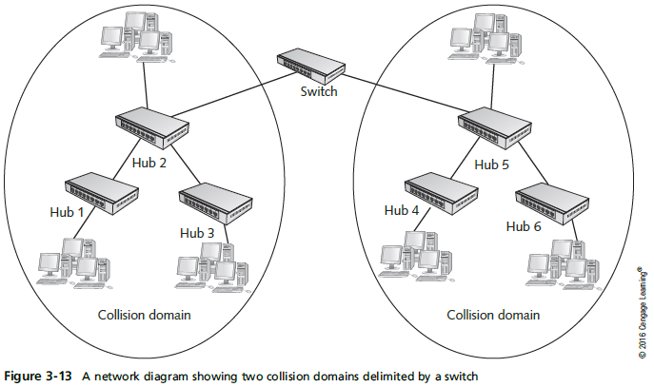
Collisions and Collision Domains
Notes:
Collisions and Collision Domains

Slide 45
Ethernet Error Handling
Ethernet is a best-effort delivery system
Like the post-office; you hope it gets there but there is no acknowledgement either way
Network protocols and applications ensure delivery
Only collisions are automatically retransmitted
Ethernet detects damaged frames
The error-checking code in an frame’s trailer is called a Cyclic Redundancy Check (CRC)
Uses CRC to determine that data is unchanged
If a frame is detected as damaged, it is discarded with no notification
Notes:
Ethernet Error Handling
Ethernet is a best-effort delivery system
Like the post-office; you hope it gets there but there is no acknowledgement either way
Network protocols and applications ensure delivery
Only collisions are automatically retransmitted
Ethernet detects damaged frames
The error-checking code in an frame’s trailer is called a Cyclic Redundancy Check (CRC)
Uses CRC to determine that data is unchanged
If a frame is detected as damaged, it is discarded with no notification

Slide 46
Half-Duplex Versus Full-Duplex Communication
Half-duplex works like a two-way radio; you can talk and listen but not both at the same time
Ethernet on hubs works only in half-duplex
Full-duplex means NIC/switch can transmit/receive simultaneously
Like a telephone
CSMA/CD is turned off
Most switches operate in full-duplex
Notes:
Half-Duplex Versus Full-Duplex Communication
Half-duplex works like a two-way radio; you can talk and listen but not both at the same time
Ethernet on hubs works only in half-duplex
Full-duplex means NIC/switch can transmit/receive simultaneously
Like a telephone
CSMA/CD is turned off
Most switches operate in full-duplex

Slide 47
Ethernet Standards
Ethernet standards expressed as:
XBaseY – 10Base2, 10BaseT, 100BaseT, 100BaseFX
Y=2 stands for coaxil cable
X – designates the speed of transmission
Y – specifies the type of media (T = twisted-pair, FX = fiber optic)
10BaseT
Uses two of the four wire pairs
Runs over Category 3(CAT 3) or higher UTP cabling
Highly susceptible to collisions and is obsolete
Notes:
Ethernet Standards
Ethernet standards expressed as:
XBaseY – 10Base2, 10BaseT, 100BaseT, 100BaseFX
X – designates the speed of transmission
Y – specifies the type of media (T = twisted-pair, FX = fiber optic)
10BaseT
Uses two of the four wire pairs
Runs over Category 3 or higher UTP cabling
Highly susceptible to collisions and is obsolete

Slide 48
Ethernet Standards
100BaseTX
Most common Ethernet variety
Runs over Category 5 or higher UTP
Uses two of four wire pairs
Two types of 100BaseTX hubs
Class I – can have only one hub between communicating devices
Class II – can have a maximum of two hubs between devices
Switches can be used to interconnect multiple hubs (see slide 43)
Notes:
Ethernet Standards
100BaseTX
Most common Ethernet variety
Runs over Category 5 or higher UTP
Uses two of four wire pairs
Two types of 100BaseTX hubs
Class I – can have only one hub between communicating devices
Class II – can have a maximum of two hubs between devices
Switches can be used to interconnect multiple hubs

Slide 49
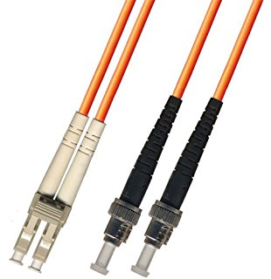
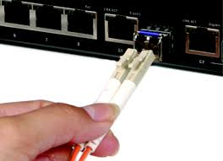
Ethernet Standards
100BaseFX
Runs over two strands of fiber optic cabling
Typically used as backbone cabling between hubs or switches
Also used to connect clients or servers when immunity to noise and eavesdropping is required
1000BaseT Ethernet
Also known as “Gigabit Ethernet”
Runs over Category 5 or higher UTP and uses all four wire pairs
Notes:
Ethernet Standards
100BaseFX
Runs over two strands of fiber optic cabling
Typically used as backbone cabling between hubs or switches
Also used to connect clients or servers when immunity to noise and eavesdropping is required
1000BaseT Ethernet
Also known as “Gigabit Ethernet”
Runs over Category 5 or higher UTP and uses all four wire pairs

Slide 50
Ethernet Standards
10GBaseT Ethernet ( 10 gigabit )
Runs over four pairs of Category 6A or 7 UTP
Operates only in full-duplex mode
No hubs, only switches support 10GBaseT
Still considered an expensive option
Good for network servers so they can keep up with desktop systems that commonly operate at 1 Gbps
Notes:
Ethernet Standards
10GBaseT Ethernet
Runs over four pairs of Category 6A or 7 UTP
Operates only in full-duplex mode
No hubs, only switches support 10GBaseT
Still considered an expensive option
Good for network servers so they can keep up with desktop systems that commonly operate at 1 Gbps

Slide 51
Additional Ethernet Standards
100BaseT4
Uses all four pairs of wires in UTP Category 3 cable
Obsolete
1000BaseLX
Uses fiber-optic media
“L” stands for “long wavelength” laser
Supports a maximum cable segment length of 5000 meters
Notes:
Additional Ethernet Standards
100BaseT4
Uses all four pairs of wires in UTP Category 3 cable
Obsolete
1000BaseLX
Uses fiber-optic media
“L” stands for “long wavelength” laser
Supports a maximum cable segment length of 5000 meters

Slide 52
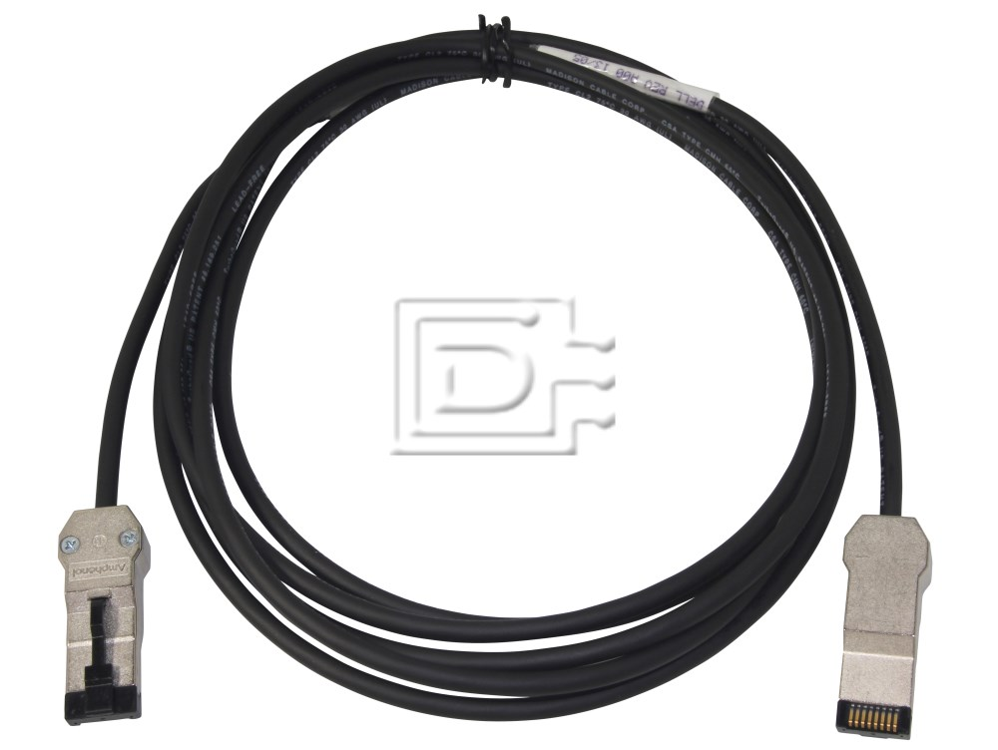
Additional Ethernet Standards
1000BaseSX
Uses fiber-optic media
“S” stands for “short wavelength” laser
Can’t cover as much distance as long-wavelength lasers, but are less expensive
1000BaseCX
Uses specially shielded, balanced, copper jumper cables
Might also be called “twinax” or “short-haul” copper cables
Notes:
Additional Ethernet Standards
1000BaseSX
Uses fiber-optic media
“S” stands for “short wavelength” laser
Can’t cover as much distance as long-wavelength lasers, but are less expensive
1000BaseCX
Uses specially shielded, balanced, copper jumper cables
Might also be called “twinax” or “short-haul” copper cables

Slide 53
Additional Ethernet Standards
10 Gigabit Ethernet IEEE 802.3ae
Much like the others in frame formats and media access
Defined to run only on fiber-optic cabling and specifies a maximum distance of 40 kilometers
Primarily used for network backbones
Varieties:
10GBaseSR, 10GBaseLR, 10GBaseER, 10GBaseSW, 10GBaseLW, and 10GBaseEW
Notes:
Additional Ethernet Standards
10 Gigabit Ethernet IEEE 802.3ae
Much like the others in frame formats and media access
Defined to run only on fiber-optic cabling and specifies a maximum distance of 40 kilometers
Primarily used for network backbones
Varieties:
10GBaseSR, 10GBaseLR, 10GBaseER, 10GBaseSW, 10GBaseLW, and 10GBaseEW

Slide 54
Additional Ethernet Standards
40 Gigabit and 100 Gigabit Ethernet
Very high cost is still prohibitive
Adoption has been slow
Fiber-optic cabling is primary medium
Although there are provisions to use special copper assemblies over short distances
Notes:
Additional Ethernet Standards
40 Gigabit and 100 Gigabit Ethernet
Very high cost is still prohibitive
Adoption has been slow
Fiber-optic cabling is primary medium
Although there are provisions to use special copper assemblies over short distances

Slide 55
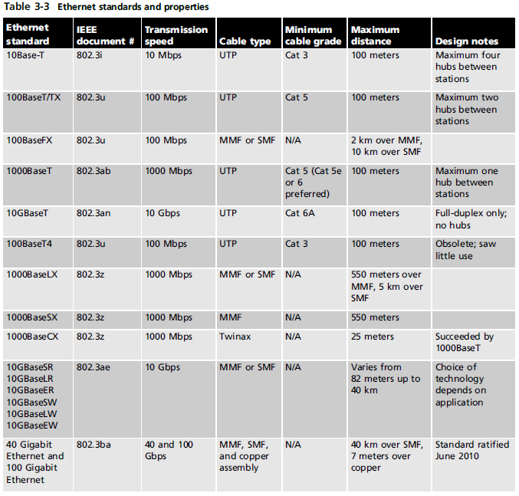
Additional Ethernet Standards
Notes:
Additional Ethernet Standards

Slide 56
802.11 Wi-Fi
The 802.11 wireless networking standard is also referred to as Wireless Fidelity (Wi-Fi)
In most towns you can usually find a public Wi-Fi network, called a hotspot
802.11 is essentially an extension to Ethernet
Using airwaves instead of cabling as the medium
Notes:
802.11 Wi-Fi
The 802.11 wireless networking standard is also referred to as Wireless Fidelity (Wi-Fi)
In most towns you can usually find a public Wi-Fi network, called a hotspot
802.11 is essentially an extension to Ethernet
Using airwaves instead of cabling as the medium

Slide 57
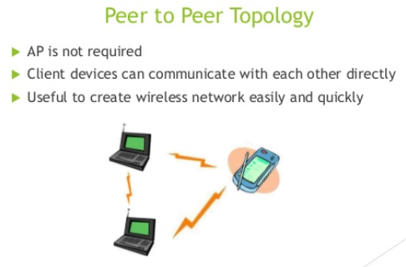
Wi-Fi Modes of Operation
Wi-Fi can operate in one of two modes
Infrastructure — use central access point (AP)
Ad hoc — no central device; data travels from device to device like a bus
Sometimes called “peer-to-peer mode”
Most of this chapter’s discussion of Wi-Fi focuses on infrastructure mode
Notes:
Wi-Fi Modes of Operation
Wi-Fi can operate in one of two modes
Infrastructure — use central access point (AP)
Ad hoc — no central device; data travels from device to device like a bus
Sometimes called “peer-to-peer mode”
Most of this chapter’s discussion of Wi-Fi focuses on infrastructure mode

Slide 58
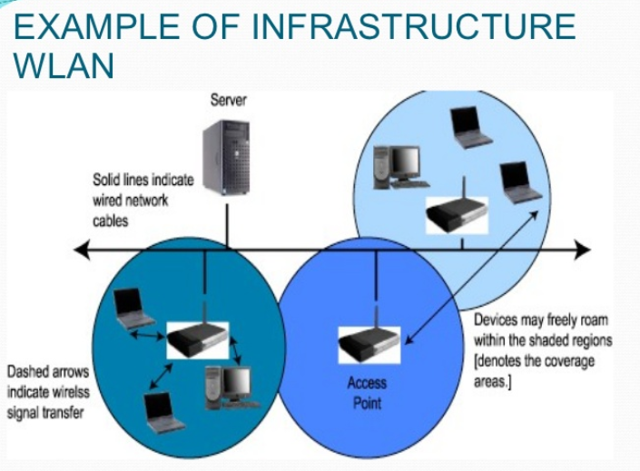
Notes:
SSID = Service Set ID

Slide 59
Wi-Fi Channels and Frequencies
Wi-Fi operate at one of two radio frequencies: 2.4GHz and 5.0 GHz
Although this frequency is not fixed
2.4 GHz is actually 2.412 thru 2.484 divided into 14 channels spaced 5 MHz apart
Work like a TV channel – you must tune to the correct channel to connect
Needs 25 MHz to operate spanning 5 channels
Choose channels five apart from other known APs
5.0 GHz is actually 4.915 thru 5.825 GHz divided into 42 channels of 10, 20, or 40 MHz each
Notes:
Wi-Fi Channels and Frequencies
Wi-Fi operate at one of two radio frequencies: 2.4GHz and 5.0 GHz
Although this frequency is not fixed
2.4 GHz is actually 2.412 thru 2.484 divided into 14 channels spaced 5 MHz apart
Work like a TV channel – you must tune to the correct channel to connect
Needs 25 MHz to operate spanning 5 channels
Choose channels five apart from other known APs
5.0 GHz is actually 4.915 thru 5.825 GHz divided into 42 channels of 10, 20, or 40 MHz each

Slide 60
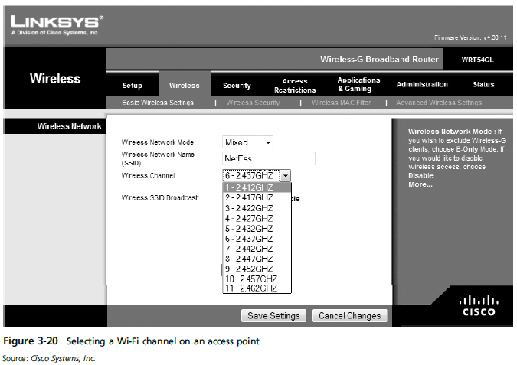
Wi-Fi Channels and Frequencies
Notes:
Wi-Fi Channels and Frequencies

Slide 61
Wi-Fi Antennas
Antenna on a Wi-Fi device is both transmitter and receiver ( Full duplex )
Characteristics and placement determine how well a device transmits or receives Wi-Fi signals
Usually categorized by their radiation pattern:
Omnidirectional antennas – signals radiate out from the antenna with equal strength in all directions
Unidirectional antenna – signals are focused in a single direction
Ideal for placement at one end of long, narrow spaces
Notes:
Wi-Fi Antennas
Antenna on a Wi-Fi device is both transmitter and receiver
Characteristics and placement determine how well a device transmits or receives Wi-Fi signals
Usually categorized by their radiation pattern:
Omnidirectional antennas – signals radiate out from the antenna with equal strength in all directions
Unidirectional antenna – signals are focused in a single direction
Ideal for placement at one end of long, narrow spaces

Slide 62
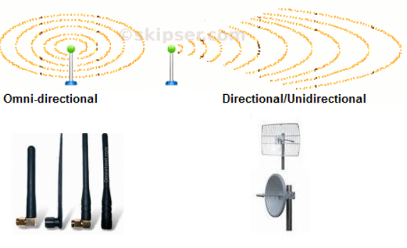

Slide 63
Wi-Fi Access Methods and Operation
Wi-Fi Access Method
Sending station can’t hear if another station begins transmitting so they cannot use the CSMA/CD access method that Ethernet uses
Wi-Fi devices use carrier sense multiple access with collision avoidance (CSMA/CA)
Uses request-to-send/clear-to-send (RTS/CTS) packets and acknowledgements
With this extra “chatter” actual throughput is essentially cut in half
Simulation 8 : Basic wireless LAN operation
Notes:
Wi-Fi Access Methods and Operation
Wi-Fi Access Method
Sending station can’t hear if another station begins transmitting so they cannot use the CSMA/CD access method that Ethernet uses
Wi-Fi devices use carrier sense multiple access with collision avoidance (CSMA/CA)
Uses request-to-send/clear-to-send (RTS/CTS) packets and acknowledgements
With this extra “chatter” actual throughput is essentially cut in half

Slide 64
Wi-Fi Signal Characteristics
Common types of signal interference:
Absorption – solid objects absorb radio signals, causing them to attenuate (weaken)
Refraction – the bending of a radio signal as it passes from a medium of one density through a medium of a different density
Diffraction – the altering of a wave as it tries to bend around an object
Reflection – occurs when a signal hits a dense, reflective material, resulting in signal loss
Scattering – when a signal changes direction in unpredictable ways, causing a loss in signal strength
Notes:
Wi-Fi Signal Characteristics
Common types of signal interference:
Absorption – solid objects absorb radio signals, causing them to attenuate (weaken)
Refraction – the bending of a radio signal as it passes from a medium of one density through a medium of a different density
Diffraction – the altering of a wave as it tries to bend around an object
Reflection – occurs when a signal hits a dense, reflective material, resulting in signal loss
Scattering – when a signal changes direction in unpredictable ways, causing a loss in signal strength

Slide 65
Wi-Fi Signal Characteristics
Signal-to-noise ratio(SNR,S/N) – the amount of noise compared with the signal strength
Noise can come from equipment, other wireless devices, and other wireless networks
Throughput – the actual amount of data transferred
Not counting errors and acknowledgements
Goodput – actual application-to-application data transfer speed
Overhead – packet frame headers, acknowledgements, and retransmissions
Notes:
Wi-Fi Signal Characteristics
Signal-to-noise ratio – the amount of noise compared with the signal strength
Noise can come from equipment, other wireless devices, and other wireless networks
Throughput – the actual amount of data transferred
Not counting errors and acknowledgements
Goodput – actual application-to-application data transfer speed
Overhead – packet frame headers, acknowledgements, and retransmissions

Slide 66
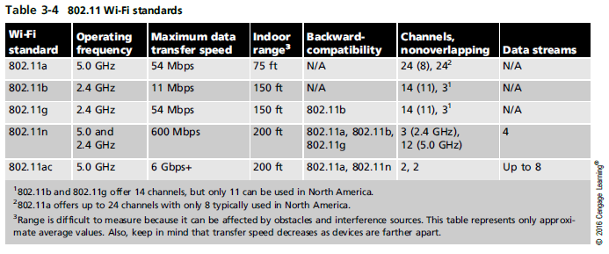
Wi-Fi Standards
Notes:
Wi-Fi Standards

Slide 67
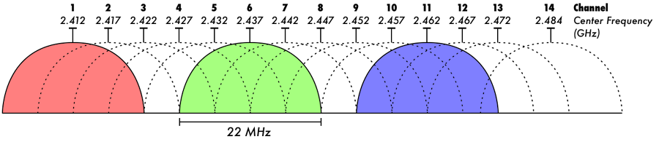
What is non-overlapping channel?
For example 802.11b and g has 14 channels
1, 6, 11 are non-overlapping
2, 7, 12 are non-overlapping
4, 8, 13 are non-overlapping etc.

Slide 68
Wi-Fi Security
Signals from a Wi-Fi network can travel several hundred feet – Wi-Fi devices outside your home or business can detect your signals
Wi-Fi network should be protected by an encryption protocol that makes data difficult to interpret
Encryption protocols
Wired equivalent privacy (WEP), Wi-Fi Protected Access (WPA), and WPA2,
Not all devices support all three protocols
Older devices might only support WEP and/or WPA
Notes:
Wi-Fi Security
Signals from a Wi-Fi network can travel several hundred feet – Wi-Fi devices outside your home or business can detect your signals
Wi-Fi network should be protected by an encryption protocol that makes data difficult to interpret
Encryption protocols
Wired equivalent privacy (WEP), Wi-Fi Protected Access (WPA), and WPA2,
Not all devices support all three protocols
Older devices might only support WEP and/or WPA

Slide 69
Token Ring Networks
Based on the IEEE 802.5 standard
Star physical topology, ring logical topology
A token is passed along the network
Only the station with the token can transmit
Frames are acknowledged and token is released
No collisions
Originally operated at 4Mbps and then increased to 16 Mbps and later 100 Mbps
Uses cat 4 and higher UTP
Obsolete
Notes:
Token Ring Networks
Based on the IEEE 802.5 standard
Star physical topology, ring logical topology
A token is passed along the network
Only the station with the token can transmit
Frames are acknowledged and token is released
No collisions
Originally operated at 4Mbps and then increased to 16 Mbps and later 100 Mbps
Uses cat 4 and higher UTP
Obsolete

Slide 70
Fiber Distributed Data Interface Technology
Physical and logical ring topology
Uses a token-passing access method and dual rings for redundancy
Transmits at 100 Mbps and can include up to 500 nodes over a distance of 60 miles
Uses fiber-optic cable only
Obsolete on new networks
Notes:
Fiber Distributed Data Interface Technology

Slide 71
Summary
Networks can be described by a physical and logical topology
The primary physical topologies are the bus, star, ring, meshed and point-to-point
The primary logical topologies are bus, ring, and switched
A network technology defines the structure of the frames and how a network interface access the medium to send data frames
Notes:
Summary
Networks can be described by a physical and logical topology
The primary physical topologies are the bus, star, ring, and point-to-point
The primary logical topologies are bus, ring, and switched
A network technology defines the structure of the frames and how a network interface access the medium to send data frames

Slide 72
Summary
The most common network technology for LANs is Ethernet
Wi-Fi is a wireless technology based on Ethernet but uses the CSMA/CA media access method
The antenna on a Wi-Fi device is both the transmitter and receiver
Wi-Fi signal interference can severely affect a WLAN’s performance and reliability
Token Ring and FDDI are both obsolete technologies that used a token passing access method
Notes:
Summary
The most common network technology for LANs is Ethernet
Wi-Fi is a wireless technology based on Ethernet but uses the CSMA/CA media access method
The antenna on a Wi-Fi device is both the transmitter and receiver
Wi-Fi signal interference can severely affect a WLAN’s performance and reliability
Token Ring and FDDI are both obsolete technologies that used a token passing access method

